Slide 1
IMAT 2904 (CTEC2902) – Advance Programming Title : Group MVC Project Group Members : Palwinder , Mohammed , Bharat , AdriAn , Harminder

Slide 2
Project Roles
Adrian – System Anaylst
Palwinder – Developer / System Analyst
Harminder – Developer
Mohammed – System Analyst
Bharat - Developer

Slide 3
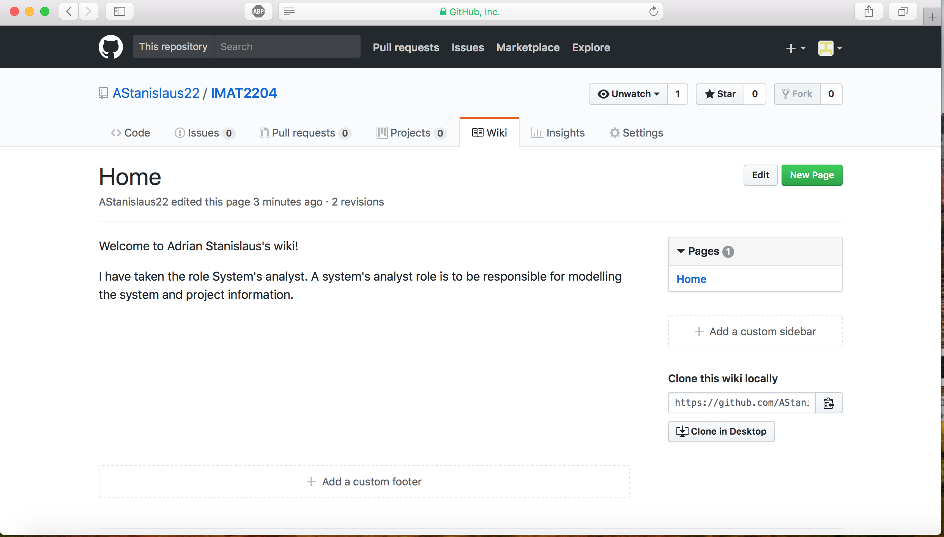
Adrian – System Analyst
I have taken the role System Analyst in this project will be to assess developers.
I am responsible to research problems and plan solutions.
Create the system model.
Adding comments.
I would also be keeping the project information intact on GitHub.

Slide 4
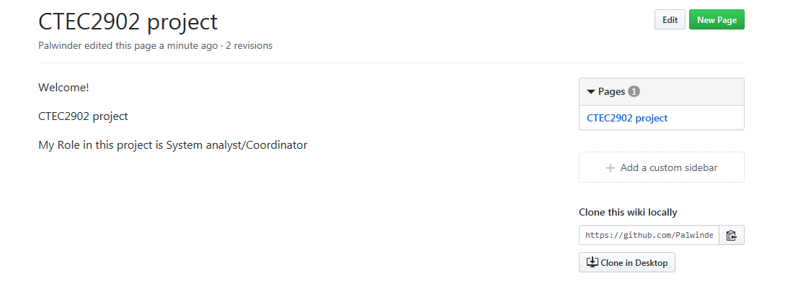
Palwinder – Developer / System Analyst
Developer / System Analyst
My role in this project will be to assess developers
Research problems, plan solutions
Checking if the team has met the requirements
Check if they are following the correct project scenario
I will also be showing good practise of coding, and assisting developers alongside in creating classes and assisting them in making web pages
I would also be keeping the project information intact on GitHub.

Slide 5
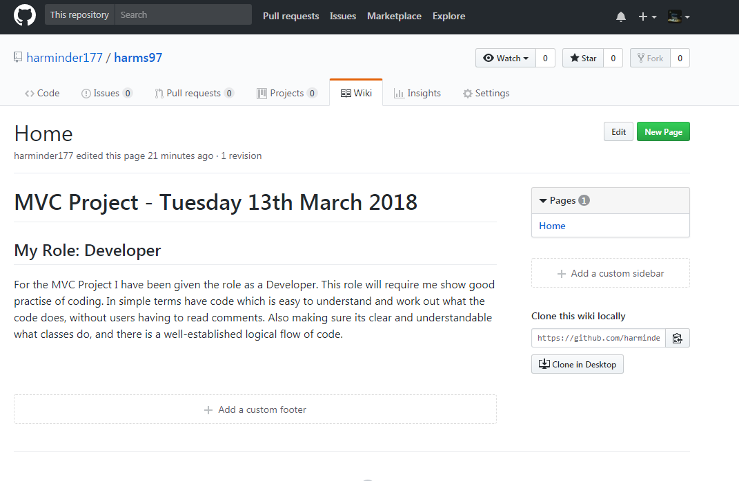
Harminder – Developer
My role is Developer
Require to show good practise of coding
In simple terms have code which is easy to understand and work out what the code does, without users having to read comments.
Also making sure its clear and understandable what classes do, and there is a well-established logical flow of code.

Slide 6
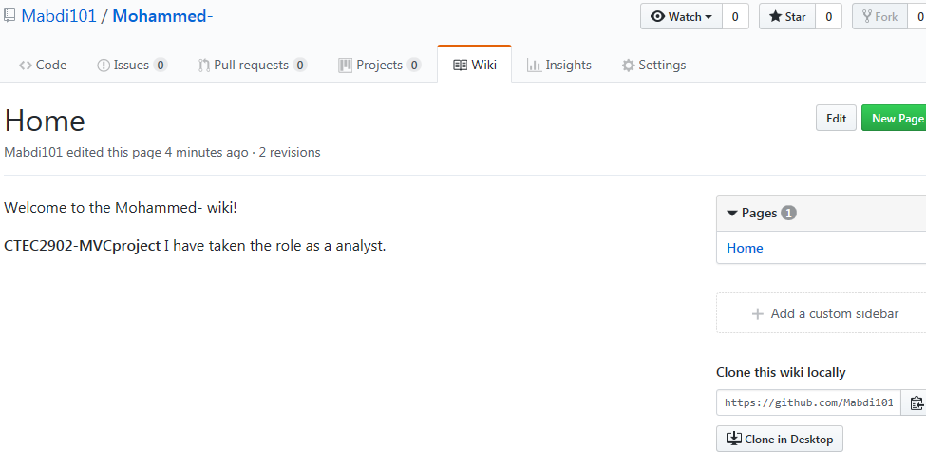
Mohammed – System Analyst
My role in this project will be System Analyst
Contributing as a system analysist and making sure all the codes are well commented and easy to understand and also recommending the developers when creating the project.

Slide 7
Bharat – Developer
Their code is organized into classes
The code runs properly, and the most common kinds of errors are anticipated and handled with meaningful properties
Using development tools to write and test code to develop these solutions
Testing and modifying systems to ensure that they operate reliably

Slide 8
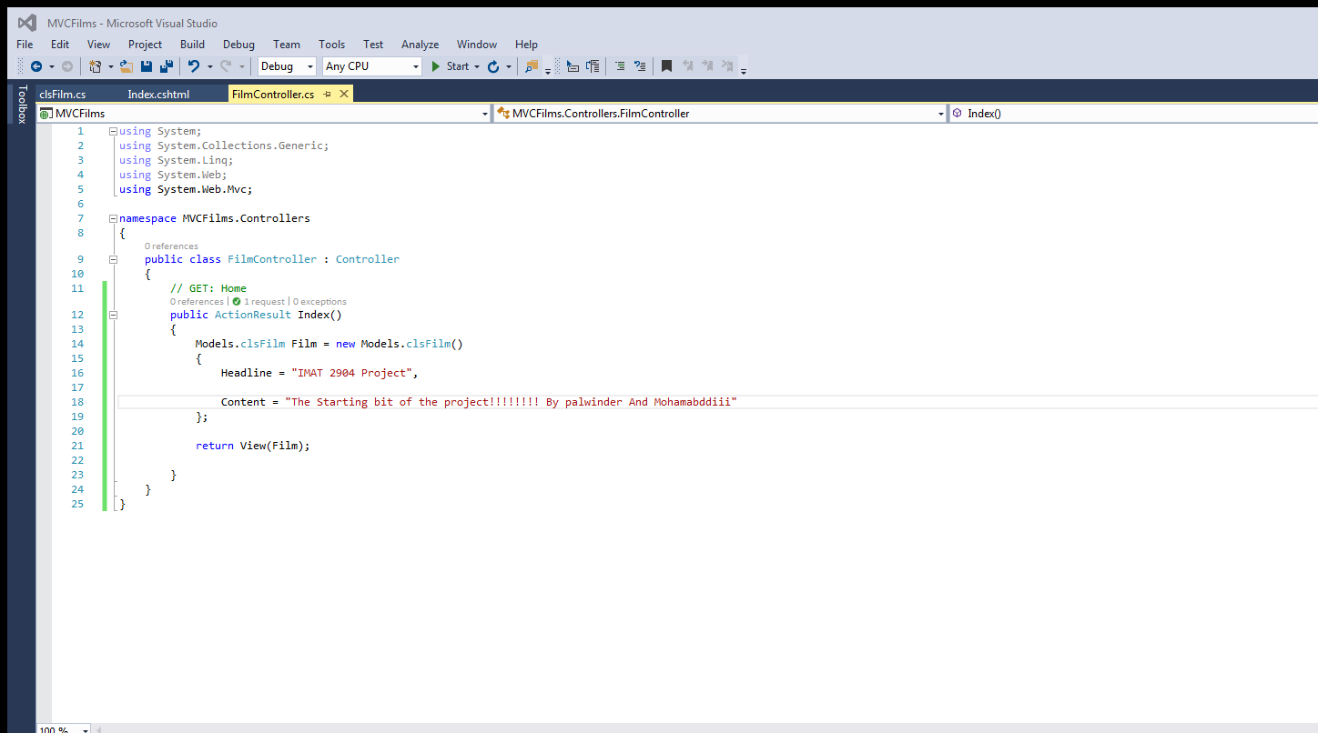
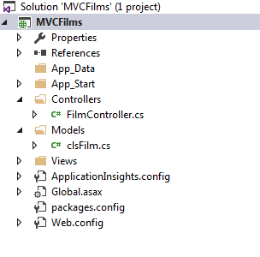
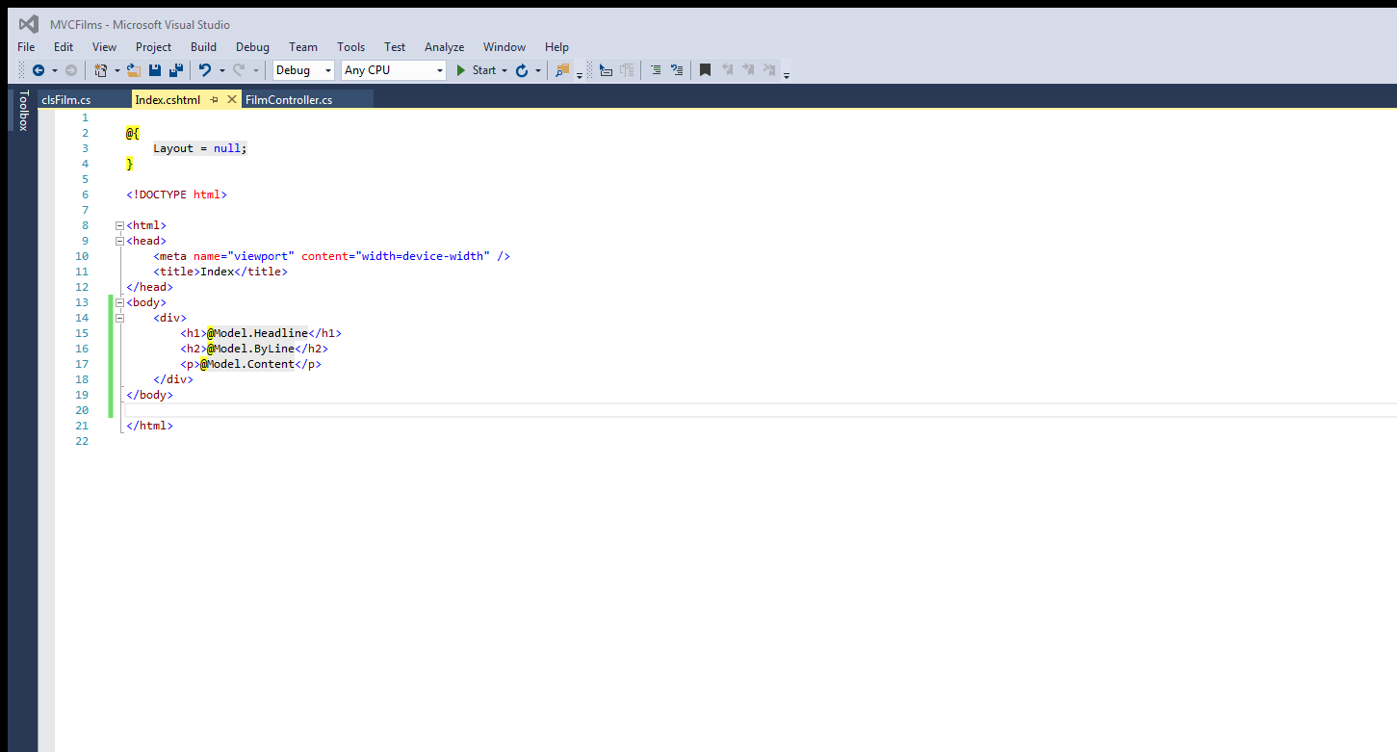
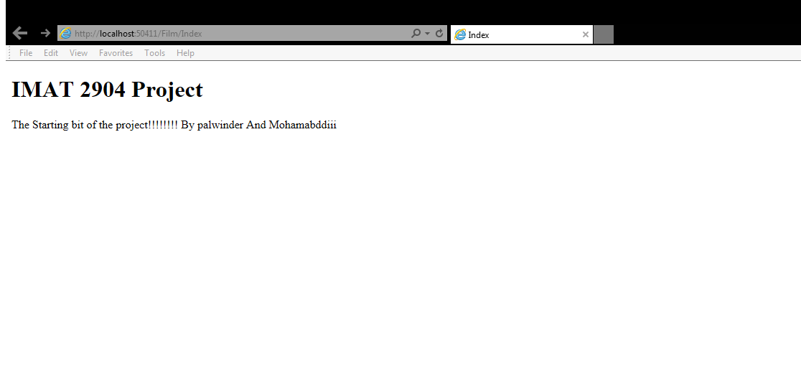
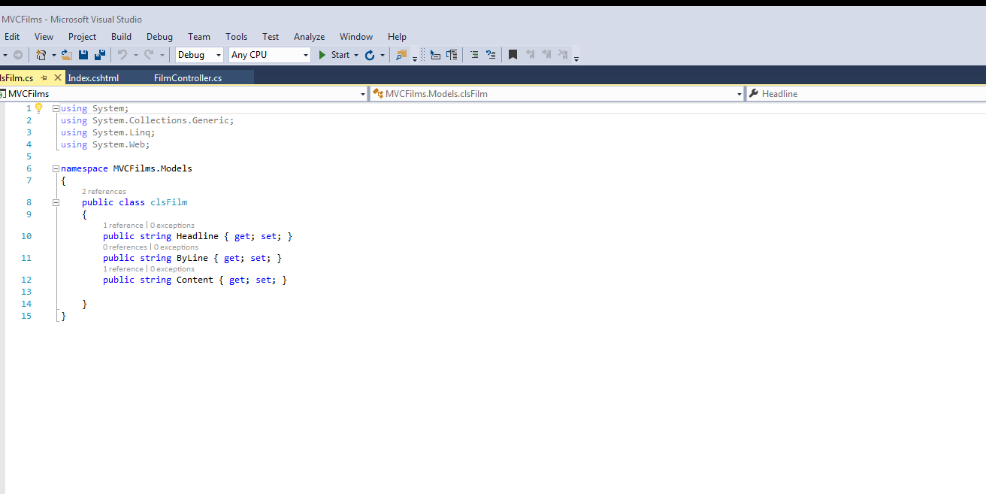
Evidence

